Slide 1
CMSC 653 Data Mining
Diabetes Project Report
Xi Gao
Oct 12th, 2010

Slide 2
Understand the Database
Class
  discharge_disposition_id (1/0)
Pattern
  encounter_id
Features
  Diagnosis
  Lab
  Medicine *

Slide 3
Select Related Feature - Diagnosis
Type I, II
  Type I : 32,909
  Type II: 342,922
Complication
  Without Complication: 302,601
  With Complication: 86,096
    Neurological Manifestation: 34,087
    Ketoacidosis: 10,779
    Ophthalmic: 12,126
    Renal: 23,040
    Other specific Manifestation: 23,475

Slide 4
Select Related Feature
Type I, II
  Type I : 32,909
  Type II: 342,922
Complication
  Without Complication: 302,601
  With Complication: 86,096
    Neurological Manifestation: 34,087
    Ketoacidosis: 10,779
    Ophthalmic: 12,126
    Renal: 23,040
    Other specific Manifestation: 23,475

Slide 5
Data Partition
 | Type I | Type II
Complication | A = 23,581 | B = 89,215
Free | C = 18,800 | D = 367,374

Slide 6
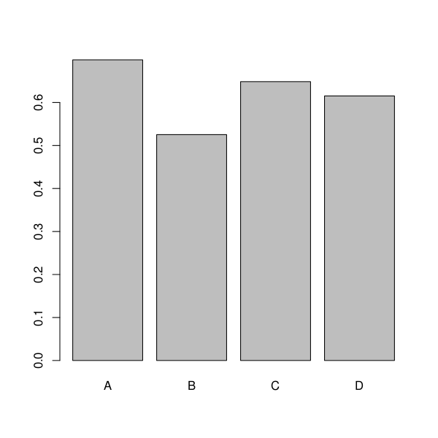
Data Partition
A B C D
0.70 0.53 0.65 0.62

Slide 7
Select Related Feature –
Lab Result
Keywords:
  Glucose
  Hemoglobin
  Cholesterol
Selected Results: 1,177,959
  Truncate NULL result: 30%
  Use as feature or class?
  Try match with med order time

Slide 8
Select Related Feature –
Medicine
Keywords: 285,283
  Acetohexamide
  Chlorpropamide
  Tolbutamide
  Glipizide
  Glyburide
  Glimepiride
  Pioglitazone
  Rosiglitazone
  Acarbose
  Miglitol
  Lactic acidosis
  Repaglinide
  Nateglinide
  Sitagliptin
  Insulin

Slide 9
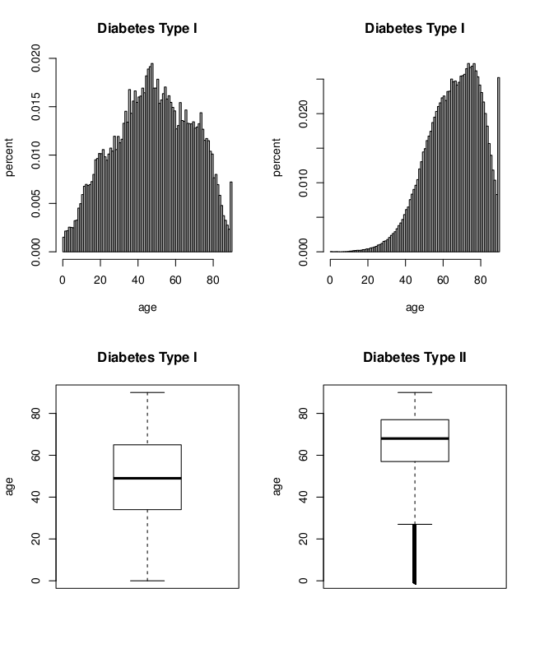
Age ~ Grouping (type I, II)

Slide 10
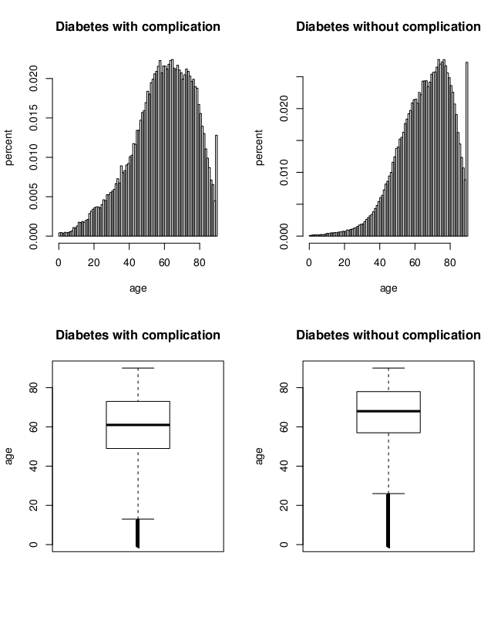
Age ~ Grouping (complication)

